Slide 1
“Power Station Management”
Presented By:-
Nagode Sandip Dattatray

Slide 2
Company Profile
Technoplanet Software Pvt .Ltd.
Technoplanet Software is a leading software and web development company ,
established in December 2012 . We offer application development , as per the clients
needs and requirements .
Goal
As a company is to customer service that is not just the best but legendary.
Vision
To be most customer centric organization .and build a place where our clients and
expertise can come together to find best business solution .
Mission
To contribute our strengths to take our client at higher position .

Slide 3
Work
We offer application development , as per the clients need and requirement . A deep
understanding of clients needs which allows effective enhancement of the their business
performance . We develop application using .net framework & PHP (Yiiframework ).
We encompass different skills and disciplines in the production and maintainance of
websites using Web Design. Indivisual will work in team covering different aspects of the
design process ,although some designers will cover them all. Our web designer have an
awareness of usability .
and if their role involes creating mark up then they are up to date to date with web
accessibilityguidelines.
Technoplanet offers design expertise and mobile usability services along with mobile with
mobile app development in Ahmednagar (Maharashtra). We have expertise in developing
Mobile application across a varity of platforms and devices . Our experience includes

Slide 4
Iphone Mobile Application Development , and Android Mobile Application Development
Our Team
“Planet of Innovation” takes great pride in the quality and integrity of Technoplanet
Software employee . We take serving our customer as seriously as we do our culture of
fun, creativity and professionalism. Our expertise works hard to ensure that the needs of of
Technoplanet clients are met . We are willing to get the extra nile to ensure customer delight .
We have strong in development client-server database driven complex information systems
with complicated GUI.
Services
Technoplanet is a product based company . We are a business aligned technology product

Slide 5
provider with proven capabilities in software application development.
The following services we provide:
Web Design and Development
Web Hosting
Application Development
Graphics and logo design
Flash Development
Content Writing

Slide 6
Existing System and Need for System
Traditionally, the power sector in Maharashtra, excluding Mumbai, was served by Maharashtra State Electricity Board (MSEB) which was set up in 1960 to generate, transmit and distribute power to all consumers in Maharashtra excluding Mumbai. Mumbai is served by three power utilities – Tata Power Company Ltd., Bombay Suburban Electric Supply (BSES) Ltd. and Bombay Electric Supply & Transport Undertaking (BEST).
MSEB’s customer base of 107,833 in 1960-61 grew to 14,009,089 in 2001-02. Due to large no of customers it is very difficult to serve them . MSEB facing lots of problems in serving new connections ,maintaining bills, searching customers area wise, tracking their readings etc.
Existing system contain manual form submission for new connection.
Manual bill delivering.

Slide 7
Drawbacks of Existing System
Existing system is time consuming.
difficult to Maintain the different power station data.
Difficult to handle large amount of customers.
Generating and submitting bills of customers for online or offline payments.
Wastage of papers for billing customer.
Leackage of electricity is not identifiable

Slide 8
Scope of Work
Scope of this project is very broad in terms of other manual power station management system.
Few of them are:-
This can be used to monitor all power stations management .
This system is really helpful to find out electricity consumption in different areas
This system can be helpful to find out dued payment of customer.

Slide 9
Operation Environment
Given below is the list of minimum recommended hardware and software.
1.4.1 Hardware
1.4.1.1 Client
Minimum P-4 machine
256MB RAM
2 GB Hard Disk
Keyboard
Mouse
Color Monitor
Printer (Optional)
U.P.S
1.4.1.2. Server
Minimum P-IV machine
2GB RAM
320GB Hard Disk
Keyboard Mouse
Color monitor
U.P.S.

Slide 10
1.4.2 Software
1.4.2.1 Client
Any Modern Browser after I.E 5.0
1.4.2.2 Server
Operating System (any one of the following)
Windows 2000.
Windows XP(Service Pack 2) Or Above
Microsoft Dot NET Framework 3.0 or above
Browser (Any Modern browser after I.E. 5.0)

Slide 11
Proposed System
Proposed System
The system has Three users Admin, Employee, Customer, The proposed system automates all the activities of these Three users.
Login -: All the 3 users have a login. They will have to login into the system using the correct username and password.
Change Password-: This feature is used by all the users to change the password.
Maintain Employee or User Records-: This feature allows admin to add a new employee or update previous records.

Slide 12
The sys­tem should introduce a paperless environment in the organisation by cov­ering end-to-end activities in the tendering process and yet provide enough control over planning and management of different tendering activities. Online connection request for new connection after registering into website, this will reduce the time span between connection request and serving the new connection. Customers will be more satisfied because of fast service and response from MSEB system. This system also contain online payments,bill summaryoptions, so customer can compare their consumption.
Admin for this system can maintain all power stations data so he can easily identify different issues like power consumption ,dued payments of customers, leackage of electricity, new connections requests, area wise reports etc.
In comparison to the present system the proposed system will be less time consuming and is more efficient.
Analysis will be very easy in proposed system as it is automated
Result will be very precise and accurate and will be declared in very short span of time because calculation and evaluations are done by the simulator itself.
The proposed system is very secure as no chances of leakage of question paper as it is dependent on the administrator only.

Slide 13
Objective of the system
Objective of System
To integrate current manual System of MSEB into online system.
Increase Customer satisfaction by online bill payment,bill summery.
Connection request etc. Integrate all power stations data into one system.
For easily maintenance and monitoring using various data mining techniques

Slide 14
User Requirements
1 Requirement Determination techniques used – Gathering relevant information for building a system is not an easy task. Therefore, there are different techniques to collect the data in an organized manner. We did it as follows:
Tried to understand the manual process and its drawbacks.
Tried to identify the time wasting process in the manual system.
2.3.2 Feasibility Study: The purpose of feasibility study is to investigate deeply the recommended system. Feasibility study is carried out to describe and evaluate the proposed system. The study will justify whether the project is feasible or not and whether it is worth while or not. Therefore, a feasibility study of the proposed system needs to be carried out in order to
Provide the better understanding of the system.
Clarify the objectives in the proposed system.

Slide 15
Describe the outputs.
There are many factors to assess while analyzing whether the proposed system is feasible and should be adopted. These factors are technical feasibility, operational feasibility and social feasibility. In order to test technical, operational and economical feasibility, the system comparisons are carried out between the proposed system and the existing system, so that the proposed system can be easily take over.
Technical Feasibility: The technical feasibility deals with some facts such as
Is the proposed system technically feasible?
Is it within the state of art?
What hardware and software will be required?
Does the management already have the software/hardware or does it have to procure them?
The technologies used to develop this system are already well established and proven. The hardware and software requirements are simple. The system is implemented as a client-server application with PostgreSQL 8.4 as the database back end and Microsoft .NET framework 2.0. The system just needs a window based machine with SQL Server installed. So the system is technically feasible.

Slide 16
Operational Feasibility: Operational feasibility deals with the human factor. It checks the impact of the proposed system on the staff. The management of the company and staff has shown interest in the development of the system. They expect the computerized system to help them to work efficiently. Retrieval of information will be easier as all the information will be stored in the database. The system will also be user friendly. Thus the proposed system is operationally feasible.
Social Feasibility: The proposed system is being implemented taking into consideration the social feasibility. User preferences and views are taken into consideration while designing the system. The system does not replace any employee of the implementing organization. It is just meant to make their work easier and to increase their productivity. In all, system is socially feasible.

Slide 17
Users Functional Requirements:
Storing employee records
Storing Customer records
Give The Request records.
Modifying application..
Viewing the Meter Wise Report..
Generating the final Bill

Slide 18
Analysis and Design

Slide 19
Use Case Diagram

Slide 20
Admin UseCase Diagram

Slide 21
Employee UseCase Diagram

Slide 22
Customer UseCase Diagram

Slide 23
Global Use case Diagram

Slide 24
Activity Diagrams

Slide 25
Login Activity Diagram

Slide 26
Registration Activity Diagram

Slide 27
Maintain Plan Activity Diagram:

Slide 28
Maintain Station Activity Diagram:

Slide 29
Maintain Area Activity Diagram :

Slide 30
Maintain Roles Activity Diagram:

Slide 31
Maintain Reading Activity:

Slide 32
Maintain Request Activity Diagram:

Slide 33
Maintain Function Activity Diagram:

Slide 34
Generate Bill Activity:

Slide 35
View Bill Activity:

Slide 36
Customer Feedback Activity:

Slide 37
View Feedback Activity:

Slide 38
Give Answer Activity:

Slide 39
Sequence Diagram

Slide 40
Login Sequence Diagram

Slide 41
Registration Sequence Diagram

Slide 42
Maintain Plan Sequence Diagram

Slide 43
Maintain Station Sequence Diagram:

Slide 44
Maintain Role Sequence Diagram

Slide 45
Maintain Function Sequence Diagram:

Slide 46
Request Sequence Diagram:

Slide 47
Maintain Reading Sequence Diagram:

Slide 48
Maintain Area Sequence Diagram:

Slide 49
Feedback Sequence Diagram:

Slide 50
FAQ Sequence Diagram:

Slide 51
Employee Sequence Diagram:

Slide 52
Generate Employee Bill Sequence Diagram:

Slide 53
Collaboration Diagram

Slide 54
Login Collaboration Diagram

Slide 55
Registration Collaboration Diagram

Slide 56
Plan :

Slide 57
Station:

Slide 58
Role:

Slide 59
Function:

Slide 60
Request:

Slide 61
Reading:

Slide 62
Area:

Slide 63
FAQ:

Slide 64
Bill:

Slide 65
Employee:

Slide 66
Componant Diagram: Login:
Registration:

Slide 67
Area:
Bill

Slide 68
Class Diagrams

Slide 70
Table Design

Slide 71
Table Design :
tbl_login:-
Name | Data type | Constraints
Lid | bigint | P.K.
uname | bigint | F.K.
Pass | nvarchar(50) | No

Slide 72
Tbl_Registration
Name | Data type | Constraints
cust_id | Bigint | P.K.
cust_name | nvarchar(50)
area_id | Bigint | F.K.
address | nvarchar(MAX)
contact | Nvarchar(50)
Uname | nvarchar(50)
pass | nvarchar(50)
status | nchar(10)
Name | Data type | Constraints
Lid | bigint | P.K.
uname | bigint | F.K.
Pass | nvarchar(50) | No

Slide 73
Tbl_Reading
Name | Data type | Primary key? | Foreign Key
Reading | bigint | Yes | No
meterno | nvarchar(50) | No | No
current_reading | nvarchar(50) | No | No
prev_reading | nvarchar(50) | No | No
units | Bigint | No | No
month | nvarchar(50) | No | No
date1 | nvarchar(50) No | No | No
year | nvarchar(50) | No | No
status | nvarchar(50) | No | No

Slide 74
Tbl_request:-
Name | Data type | Primary key? | Foreign Key
id | Bigint | Yes | No
cust_id | Bigint | No | Yes
plan_id | Bigint | No | Yes
meter_no | nvarchar(50) | No | No
pc | nvarchar(50) | No | No
dtcn | nvarchar(50) | No | No
polno | nvarchar(50) | No | No
supply_date | nvarchar(50) | No | No
granted | nvarchar(50) | No | No

Slide 75
Tbl_Area
Name | Data type | Primary key? | Foreign Key
area_id | Bigint | Yes | No
station_id | Bigint | No | Yes
area_name | nvarchar(50) | No | No
status | nchar(10) | No | No

Slide 76
Tbl_Station:-
Name | Data type | Primary key? | Foreign Key
station_id | Bigint | Yes | No
station_name | nvarchar(50) | No | Yes
address | nvarchar(50) | No | No
contact | nvarchar(50) | No | No
contact_per | nvarchar(50) | No | No
flag | nvarchar(50) | No | No

Slide 77
Tbl_Employee_Reg:-
Name | Data type | Primary key? | Foreign Key
emp_id | Bigint | Yes | Yes
station_id | Bigint | No | Yes
role_id | Bigint | No | Yes
emp_name | nvarchar(50) | No | No
address | nvarchar(50) | No | No
contact | nvarchar(50) | No | No
uname | nvarchar(50) | No | No
pass | nvarchar(50) | No | No
flag | nchar(10) | No | No

Slide 78
Tbl_Role:-
Name | Data type | Primary key? | Foreign Key
role_id | bigint | Yes | No
Role | nvarchar(50) | No | No
Flag | nchar(10) | No | No

Slide 79
Tbl_Plan:-
Name | Data type | Primary key? | Foreign Key
plan_id | bigint | Yes | No
plan_name | nvarchar(50) | No | No
Rate | float | No | No
lower_limit | Int | No | No
Upperlimit | Int | No | No
light_rent | float | No | No
Type | nvarchar(50) | No | No
Flag | nchar(10) | No | No

Slide 80
Tbl_Bill:-
Name | Data type | Primary key? | Foreign Key
bill_id | Bigint | Yes | No
read_id | Bigint | No | Yes
Fine | Float | No | No
bill_date | nvarchar(50) | No | No
last_date | nvarchar(50) | No | No
Total | Float | No | No
Paid | nvarchar(50) | No | No
Status | nchar(10) | No | No

Slide 81
Tbl_Faq :-
Name | Data type | Primary key? | Foreign Key
faq_id | bigint | Yes | No
cust_id | bigint | No | Yes
Query | nvarchar(50) | No | No
Flag | nchar(10) | No | No

Slide 82
Tbl_Function:-
Name | Data type | Primary key? | Foreign Key
Fid | bigint | Yes | No
cust_id | bigint | No | Yes
feedback | nvarchar(50) | No | No
Flag | nchar(50) | No | No

Slide 83
Tbl_FeedBack:-
Name | Data type | Primary key? | Foreign Key
fun_id | bigint | Yes | No
fun | nvarchar(50) | No | No
flag | nchar(50) | No | No

Slide 84
Tbl_Give_Ans:-
Name | Data type | Primary key? | Foreign Key
ans_id | bigint | Yes | No
faq_id | bigint | No | Yes
ans | nvarchar(50) | No | No
flag | nchar(50) | Yes | No

Slide 85
Tbl_Give_Ans:-
Name | Data type | Primary key? | Foreign Key
ans_id | bigint | Yes | No
faq_id | bigint | No | Yes
ans | nvarchar(50) | No | No
flag | nchar(50) | Yes | No

Slide 86
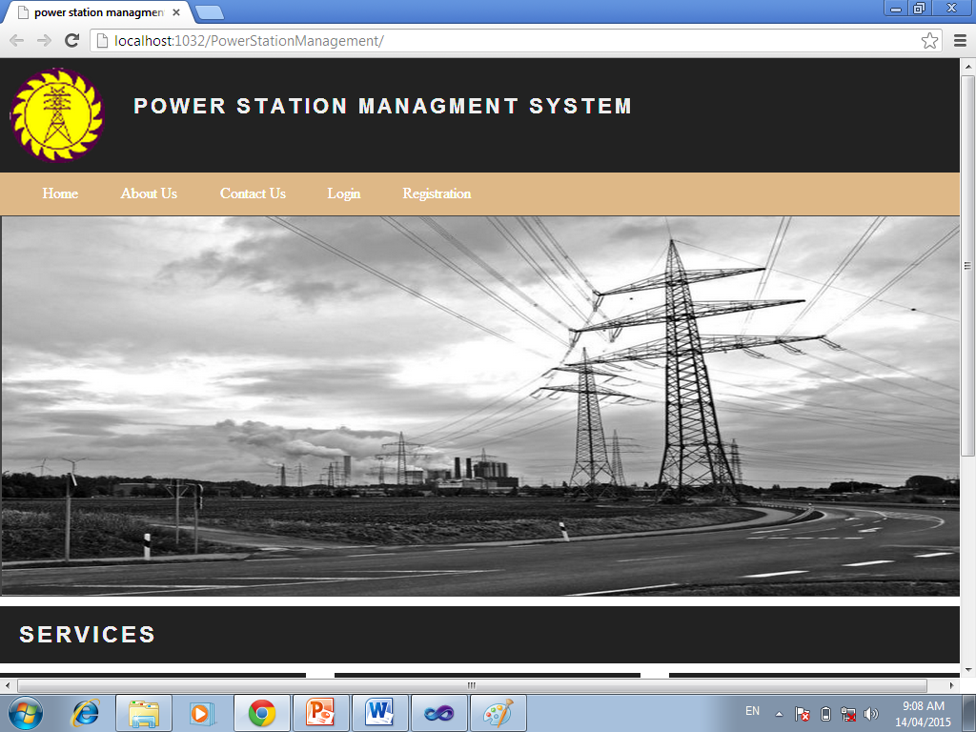
USER INTERFACE SCREENS
Home Page :

Slide 87
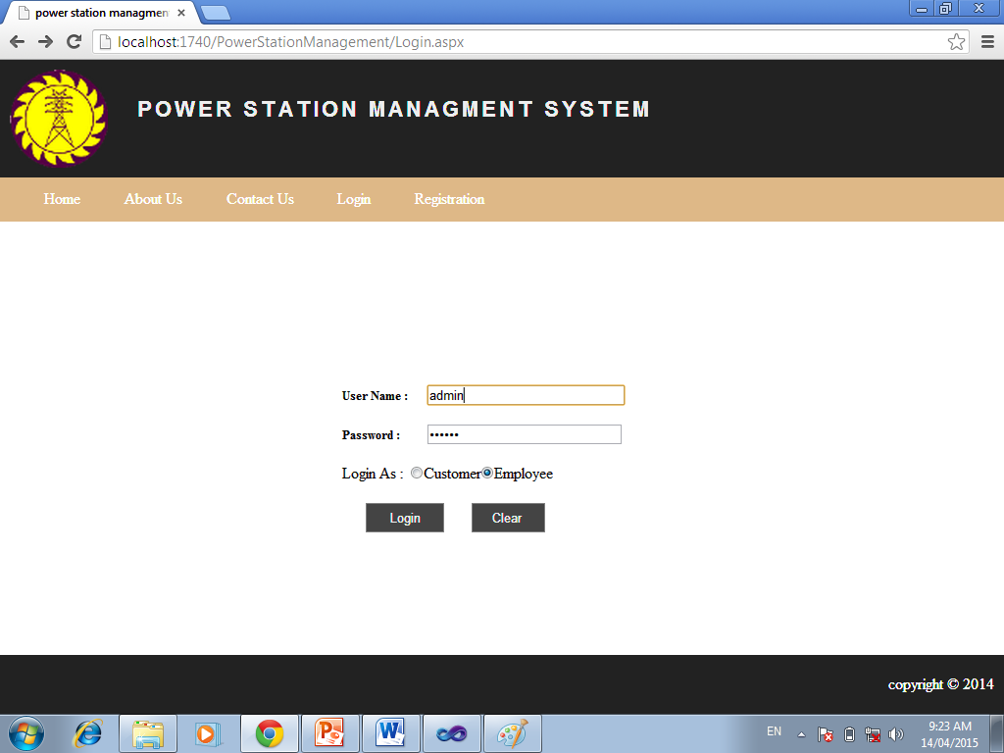
Login

Slide 88
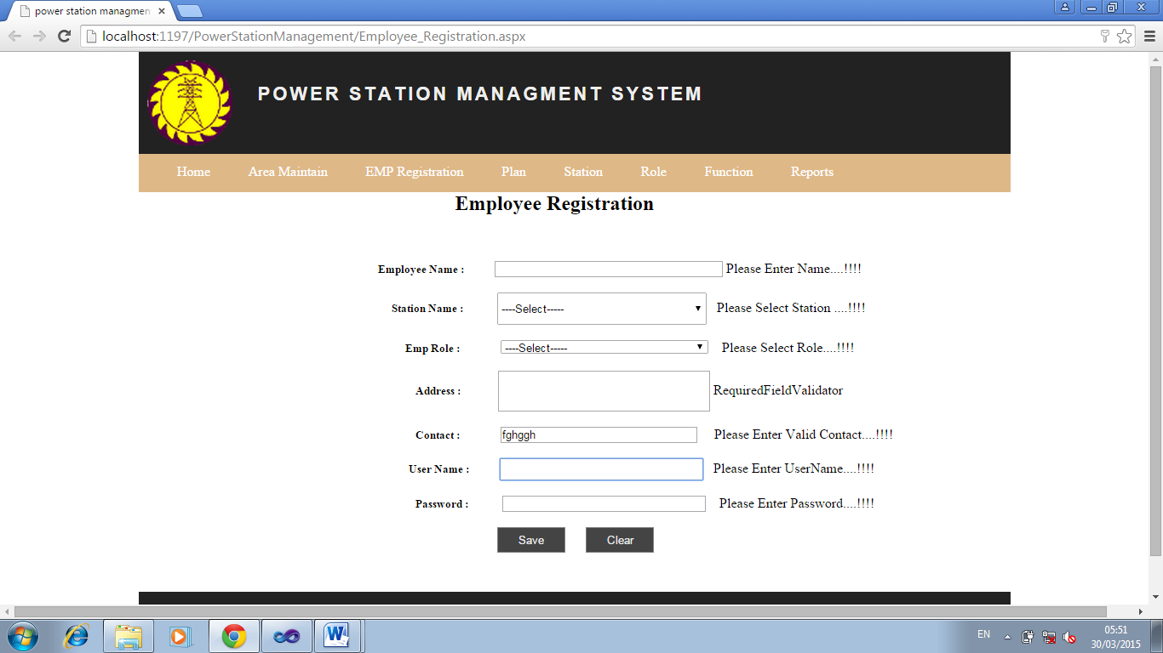
Admin:-Employee Registration Form:-

Slide 89
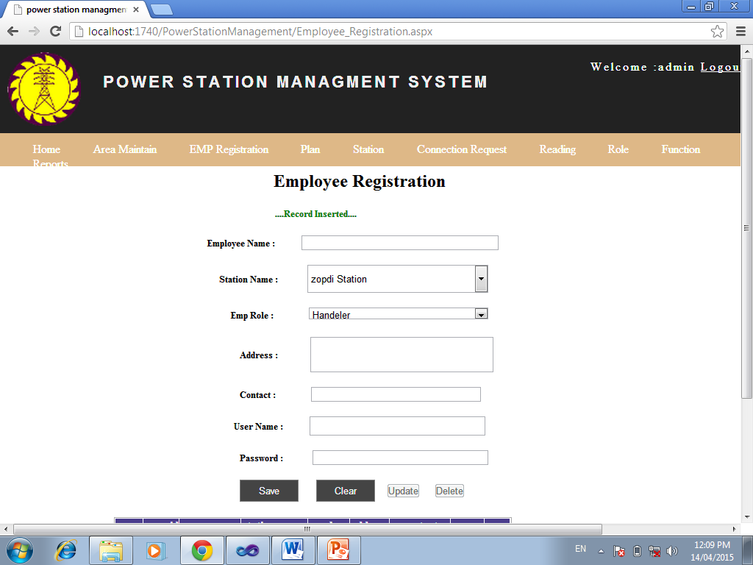
Employee Register:-

Slide 90
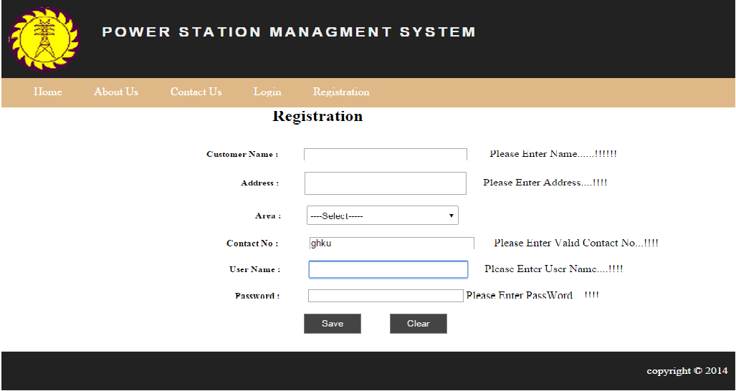
Customer Registration Validate :-

Slide 91
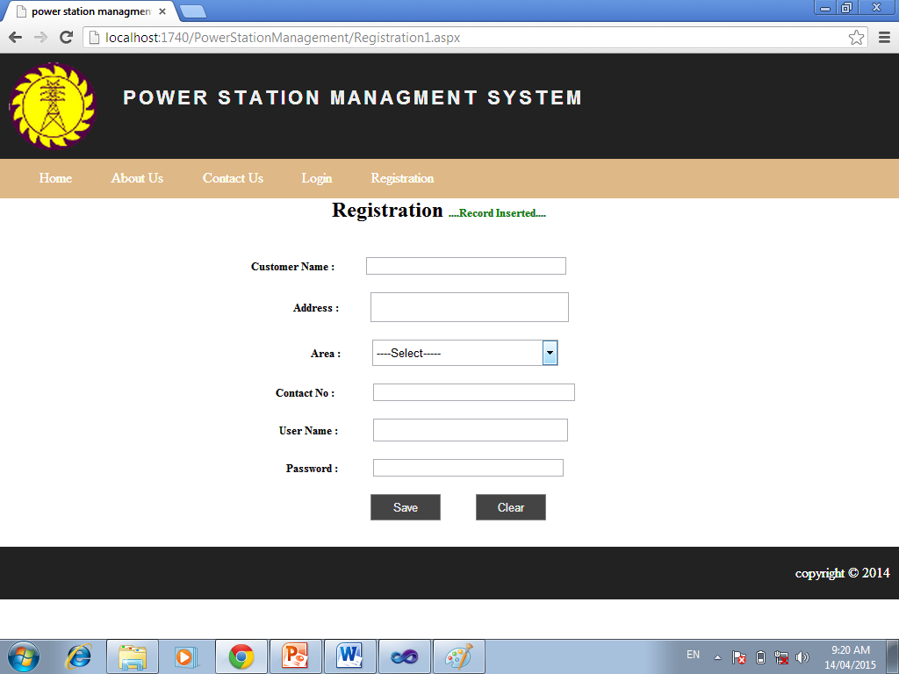
Student Register :-

Slide 92
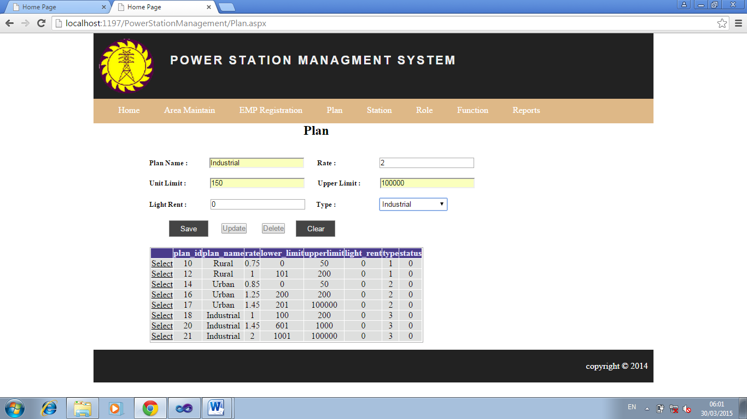
Maintain Plan:-

Slide 93
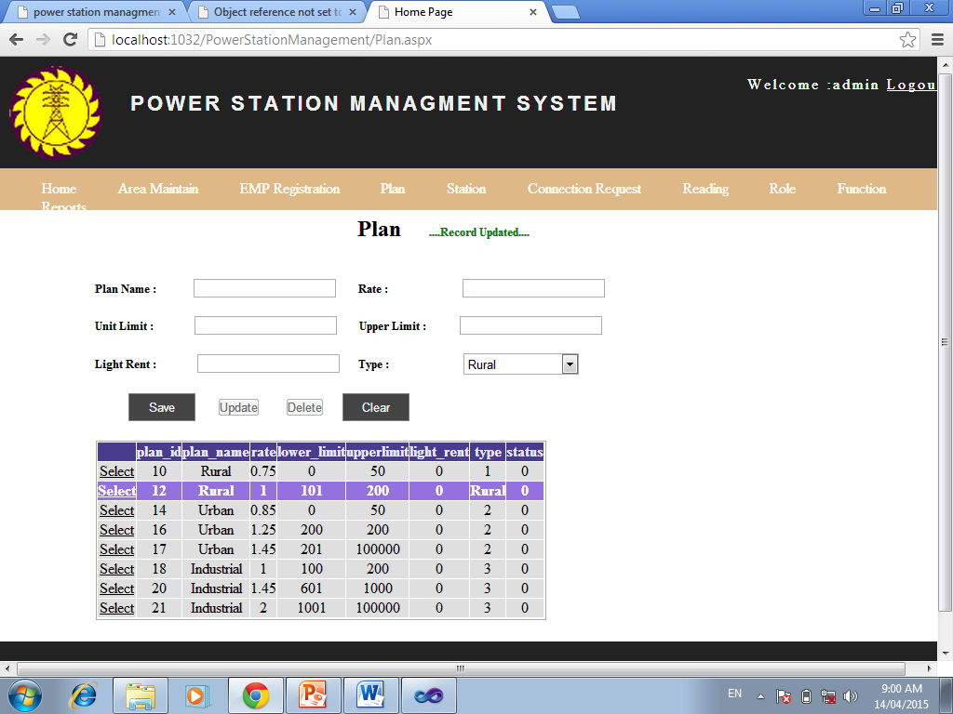
Update Record:-

Slide 94
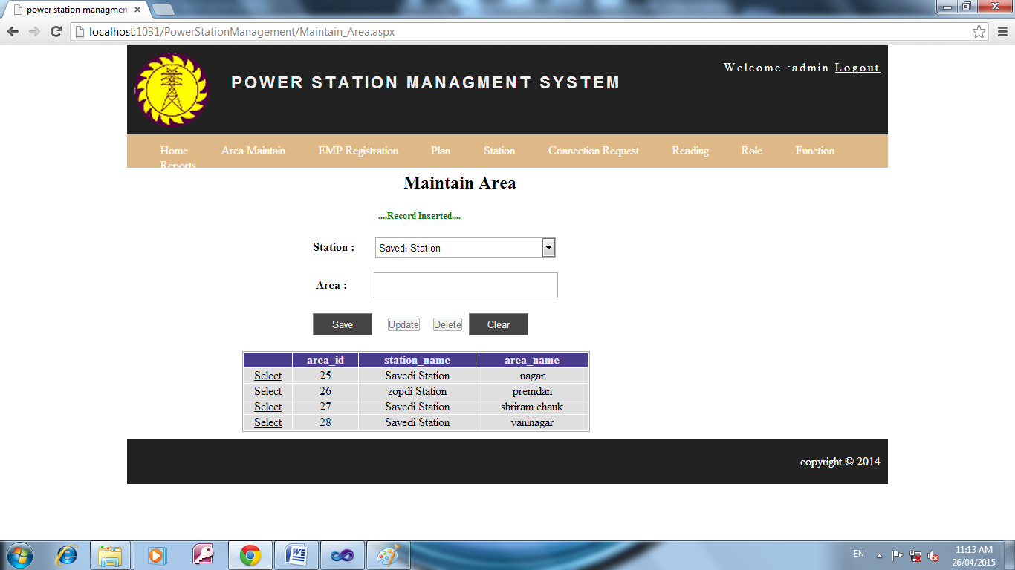
Delete Record

Slide 95
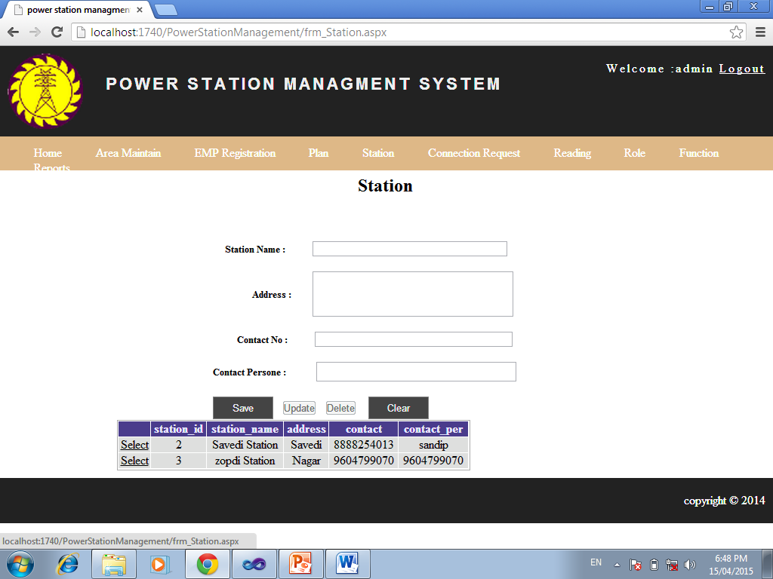
Station Info:-

Slide 96

Maintain Area :-

Slide 97
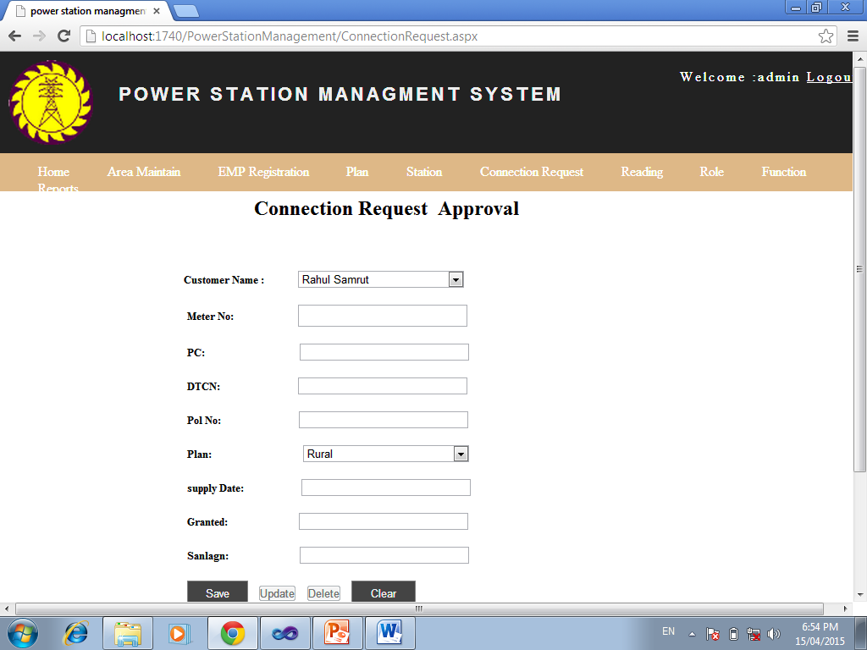
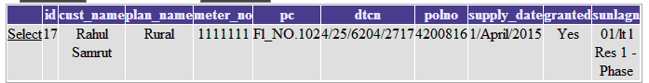
Connection Request:-

Slide 98
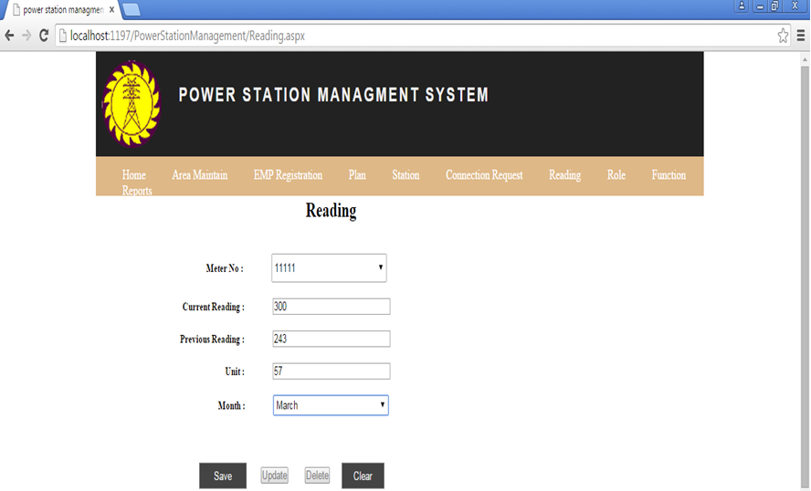
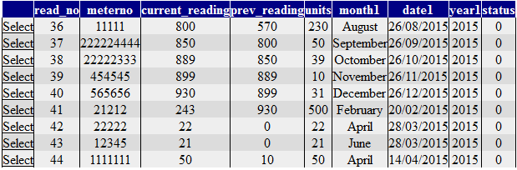
Reading:-

Slide 99
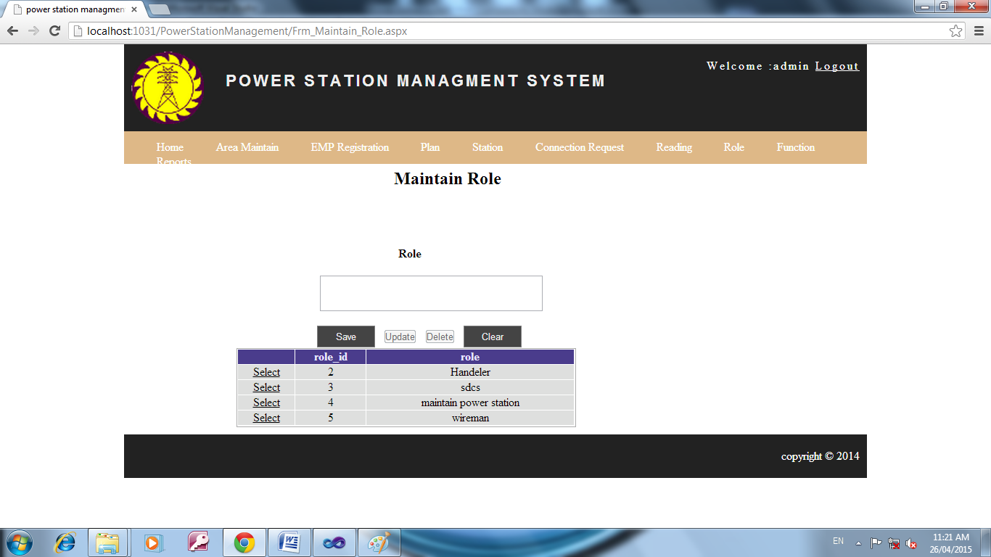
MaintainRole:-

Slide 100
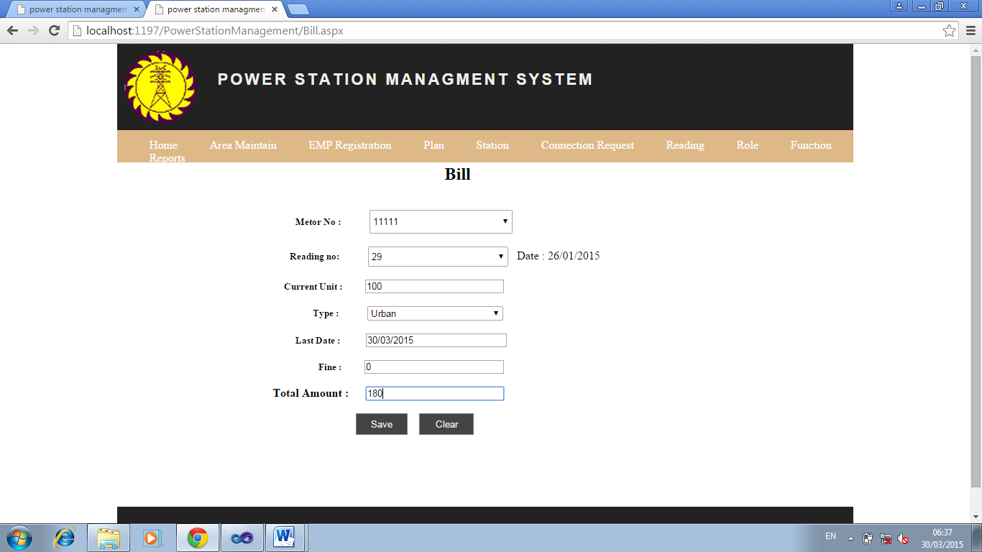
Generate Bill:-

Slide 101
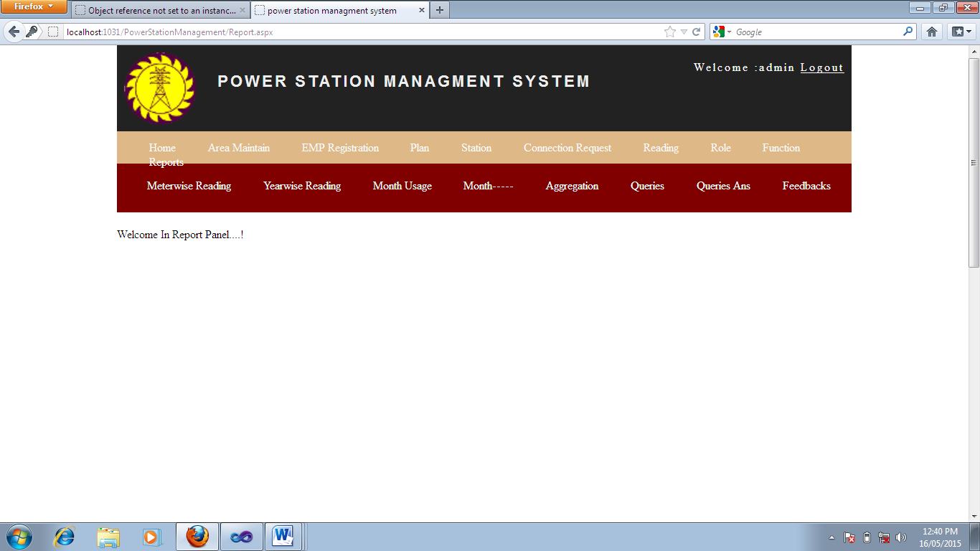
Admin Report Report Panel :-

Slide 102
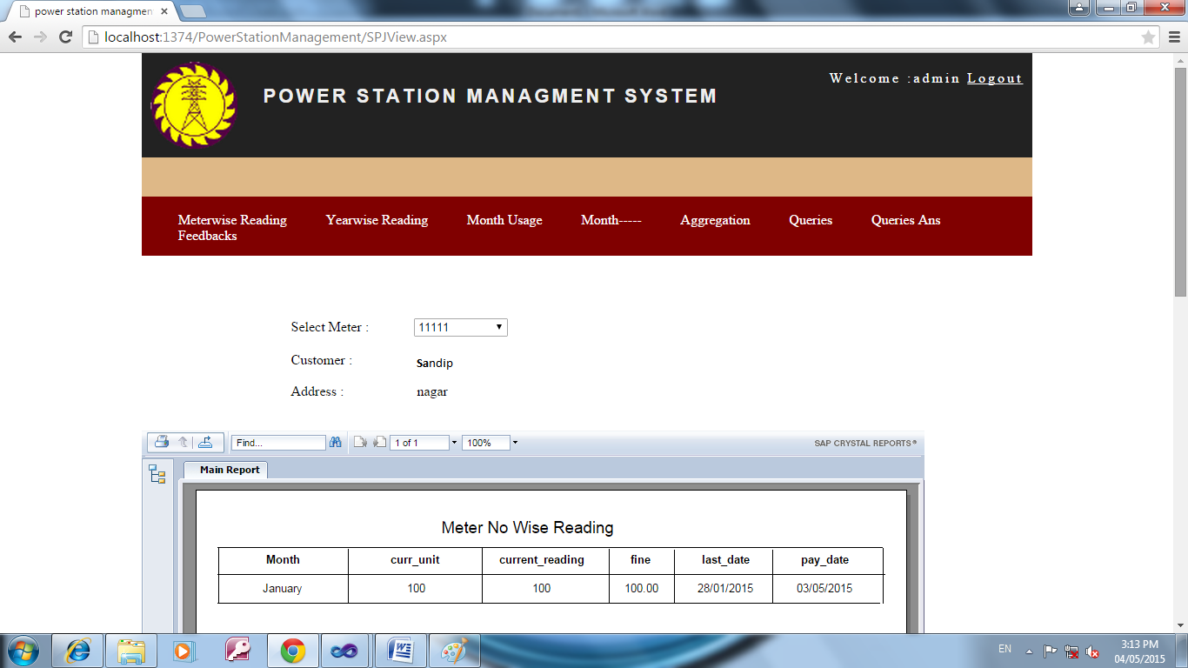
MeterNo Wise Report :

Slide 103
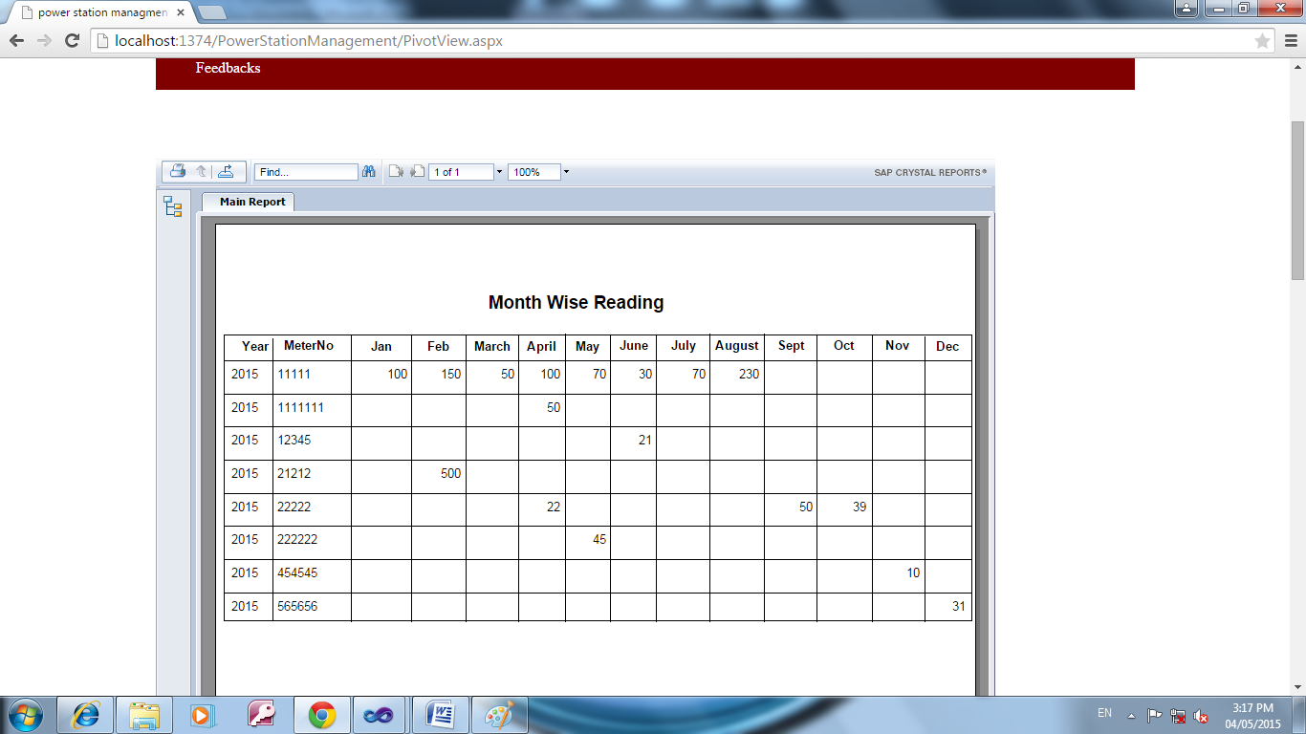
Monthwise Reading Report

Slide 104
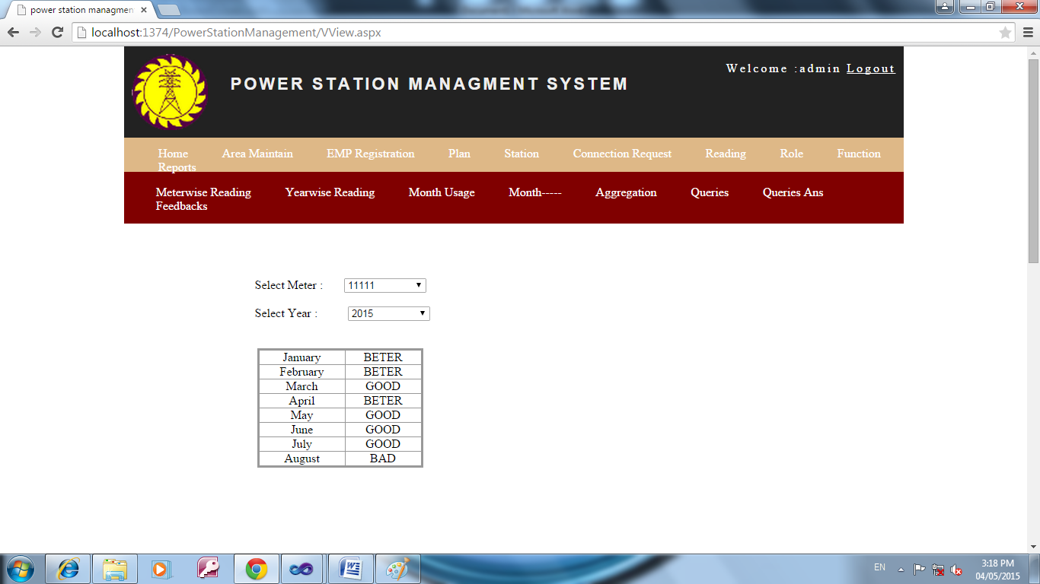
Usagewise Report

Slide 105
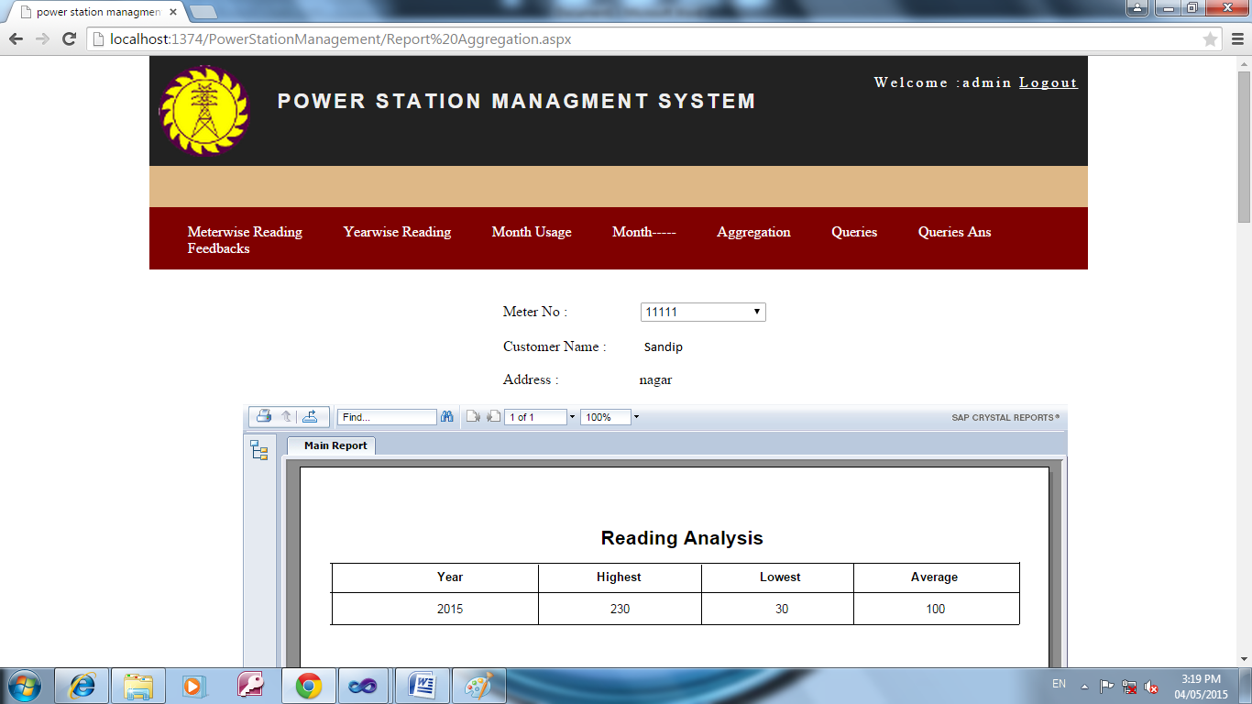
Reading Analysis

Slide 106
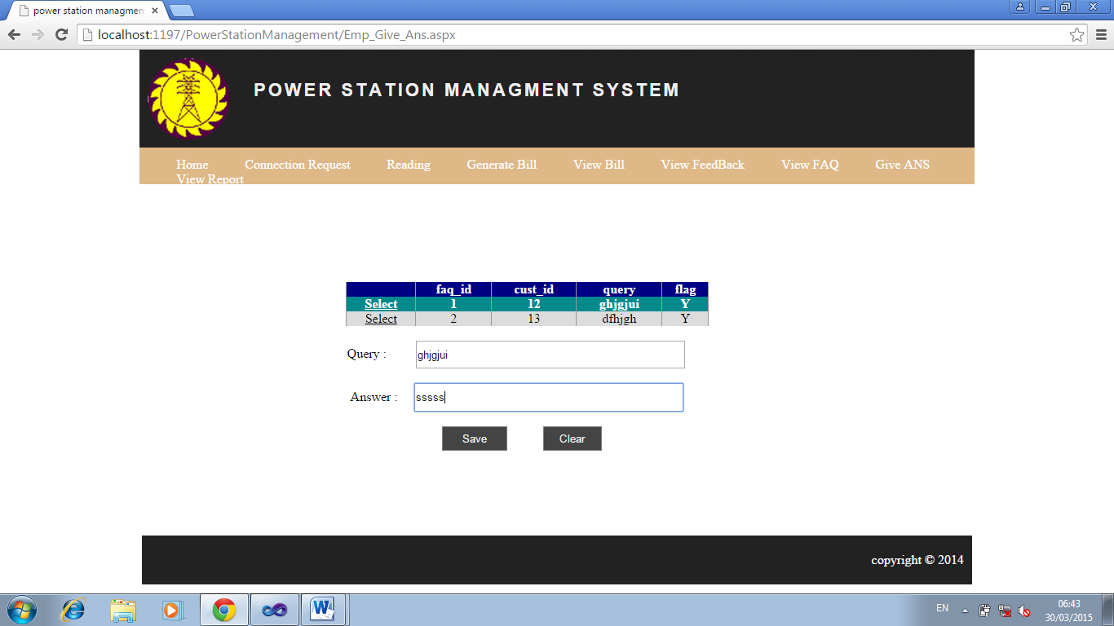
Give Ans:-

Slide 107
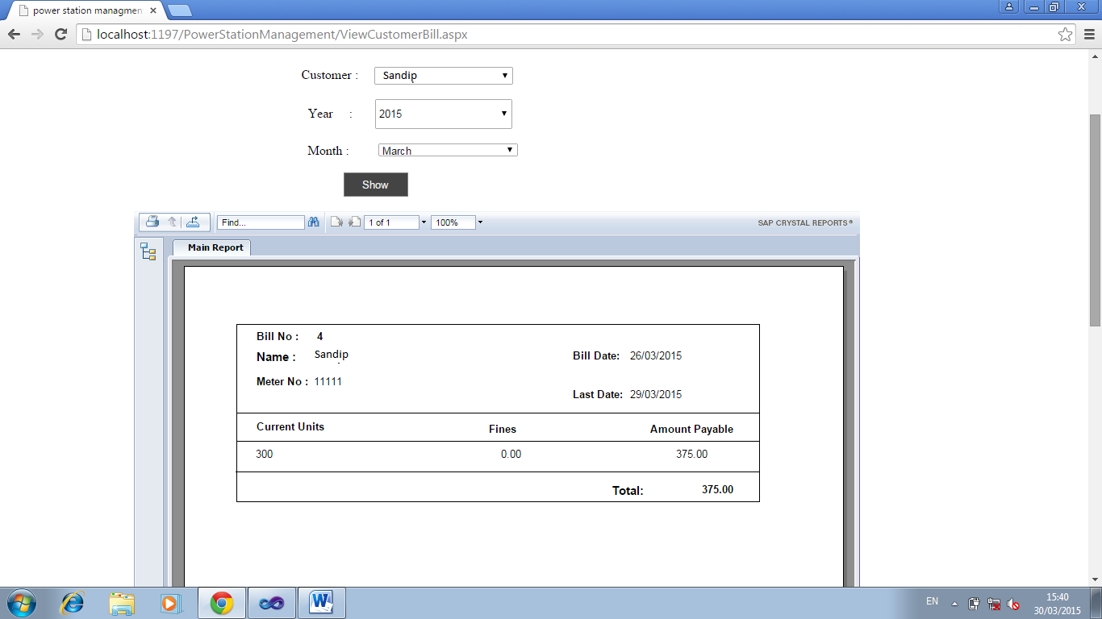
Employee View Customer Bill

Slide 108
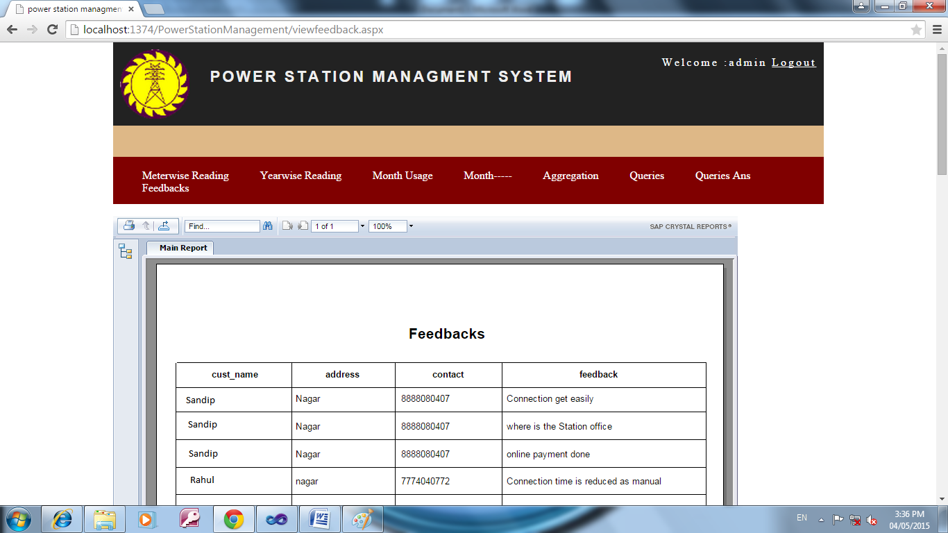
Feedbacks Report

Slide 109

Queries by Customer

Slide 110
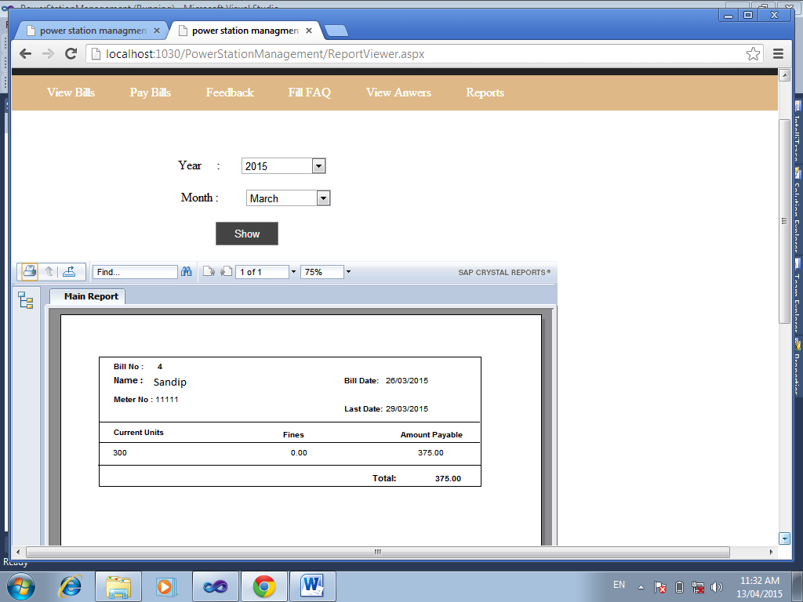
Customer: Customer View Bill:-

Slide 111
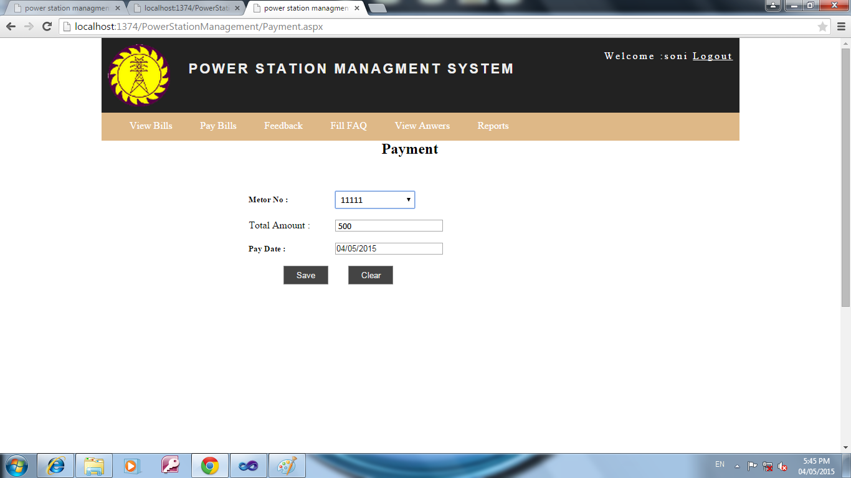
Customer Does Payment

Slide 112
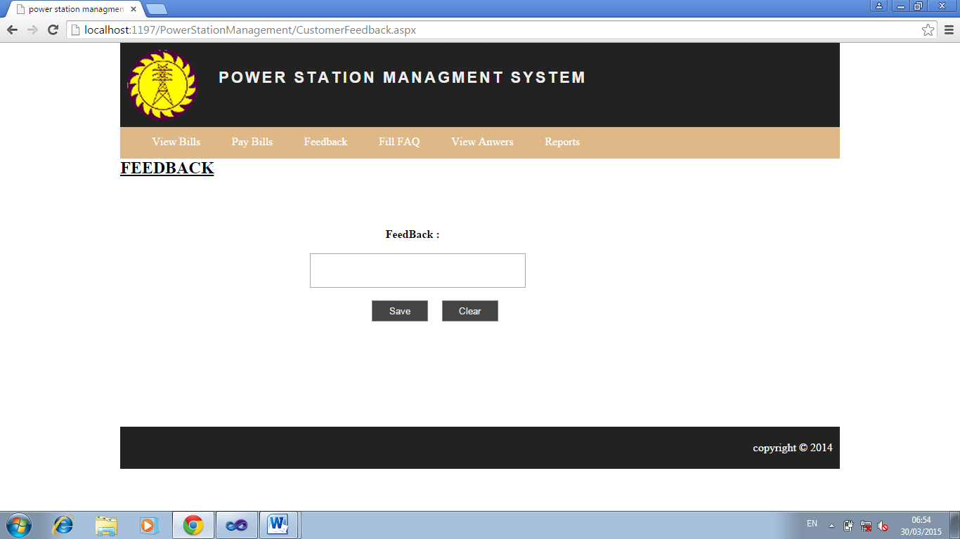
FeedBack:-

Slide 113
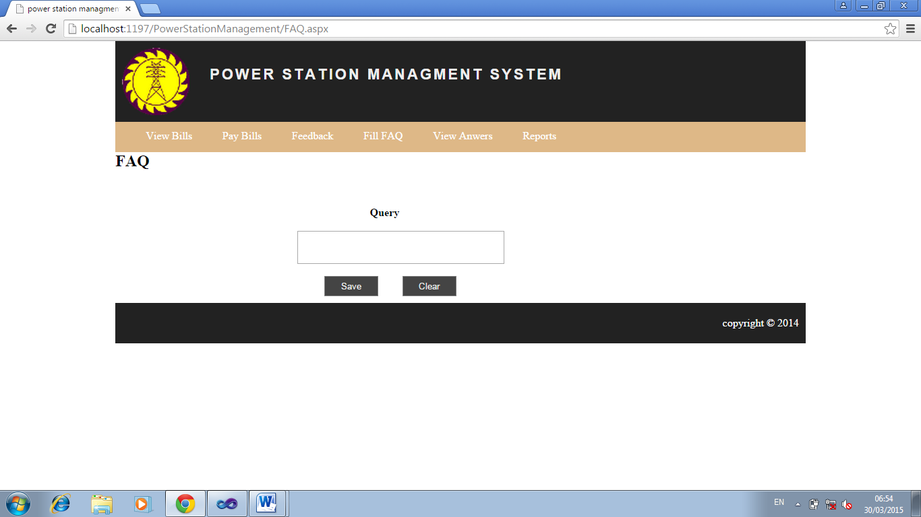
FAQ:-

Slide 114
Test Cases

Slide 115
Test Case for Login
Test Case id | LOGIN_2
Test Case Name | Test case for Login
Pre Requisites | Application Running & irrespective of the page
Step No | Step to be executed | Expected Result | Actual result | Pass / fail | Remark | Defect id
1 | Enter invalid username and password | Invalid username and password should be displayed | Page is redirected to same page | Pass | Invalid username and password are checked | Nil
2 | Enter valid username and password | Page re-directed to respective home page(user/admin) | Page re-directed to respective home page(user/admin) | Pass | Invalid username and password are checked | Nil

Slide 116
Email Validation
Test Case id |  |  |  | Email Validate
Test Case Name |  |  |  | Test case for email
Step No | Step to be executed | Expected Result | Actual result |  | Pass / fail | Remark | Defect id
1 | Enter invalid email without ‘@’or’.’ | Invalid email Message should be displayed | Invalid email Message is displayed |  | Pass | Invalid email is checked | Nil
2 | Enter valid email | System Should accept and proceed | Enter email gets displayed in textbox |  | Pass | Valid email is checked | Nil

Slide 117
Test case id : Character validate
Test Case name: Character input
Step No | Step to be executed | Expected Result | Actual result | Pass / fail | Remark | Defect id
1 | Enter Numeric value in text box | Invalid Character Error Message should be displayed | Invalid Character Error Message is displayed | Pass | Invalid Entries are checked | Nil
2 | Enter Special character | Invalid Character Error Message should be displayed | Invalid Character Error Message is displayed | Pass | Invalid Entries are checked | Nil
3 | Enter characters | System Should accept and proceed | Valid Character is entered and cursor transferred to next field | Pass | Characters are checked | Nil

Slide 118
Teat case id: Number validate
Test case name: Number checking
Step No | Step to be executed | Expected Result | Actual result | Pass / fail | Remark | Defect id
1 | Enter Special character or Alpabets | Invalid Character Error Message should be displayed | Invalid Character Error Message is displayed | Pass | Invalid Entries are checked | Nil
2 | Enter Numeric value in text box | System Should accept and proceed | Valid Character is entered and cursor transferred to next field | Pass | Valid Entries are checked | Nil

Slide 119
Drawbacks and Limitations

Slide 120
Drawbacks
Major efforts have been taken to complete this system but still it has some drawbacks. The main drawbacks of the system are
Help facility and information about the system would be insufficient.
Computer being an electronic machine its feature are always incompatible to human being.
The System is not fully automated system.

Slide 121
Limitations
System has following limitations –
The backend technology if changed at some later times may consume much time to get implemented.
Parallel implementation cannot be rendered at a time.
System is not customizable to its look and feel.
User needs some sorts of training before using the system.
User should be able to understand all the technical terms associated with the system before handling it.
The system cannot function without internet connection.

Slide 122
Proposed Enhancement

Slide 123
FUTURE ENHANCEMENT:
This can be used in Cunstuction companies as well as in corporate world.
Can be used anywhere any time as it is a web based application (user location doesn’t matter).
No restriction of member should be present at the time of project deals.

Slide 124
Conclusion

Slide 125
The whole idea behind this project is pretty good and it really secures online posting projects ,transfer payments, paying subscription ,provide insurance to both entities client as well developer. After getting insured somewhat they fill relax and have guarantee of completion of Project, refund and Payment etc.
This system further can be generalized so that it can be useful to enhance online business.
It Optimizes the time, overall money for travelling, etc . Helpful for doing business in case of physically separated entities.

Slide 126
Thank You

